Slide 1
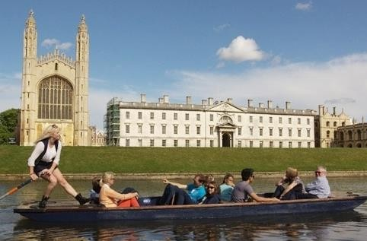
The University of Cambridge Judge Business School Summer Programme
The University of Cambridge Judge Business School invites international students onto a professional and intensive residential summer programme in the city of Cambridge.
The teaching style is interactive and fast-paced; the teaching staff look to challenge students at all times in order to encourage their development.
Personal Developement for Performance Capability
This 2- or 3-week programme is created with the personal development of each student as the foremost objective and this is reflected in each of the complementary elements, overseen by Professor Christoph Loch. This programme is suitable for all students aged between 14 to 18.
Agent Prices (NET)
Included in the price:
2 weeks: £3,220
3 weeks: £4,485
Airport transfers
Accommodation
Full board
Company visits
CJBS certificate
Course materials
Travel insurance
Key elements of this programme include:
2020 Dates
weeks: 25th July to 8th August
weeks: 25th July to 15th August
English language lessons
Keynote speeches
Company visits
Professionally led sport sessions
Cultural excursions into Cambridge & London
📩 naito@starnavigation.jp

Slide 2
Sample Programme
This is a sample programme of our 2-week Cambridge Judge Business School summer programme.
Day | Morning |  |  | Afternoon |  |  | Evening
12/2
In the heart of Cambridge, learning from professionally qualified high-calibre staff, with the specialist support of recent graduates of Cambridge Judge Business School's prestigious MBA programme.
📩 naito@starnavigation.jp

